Slide 1
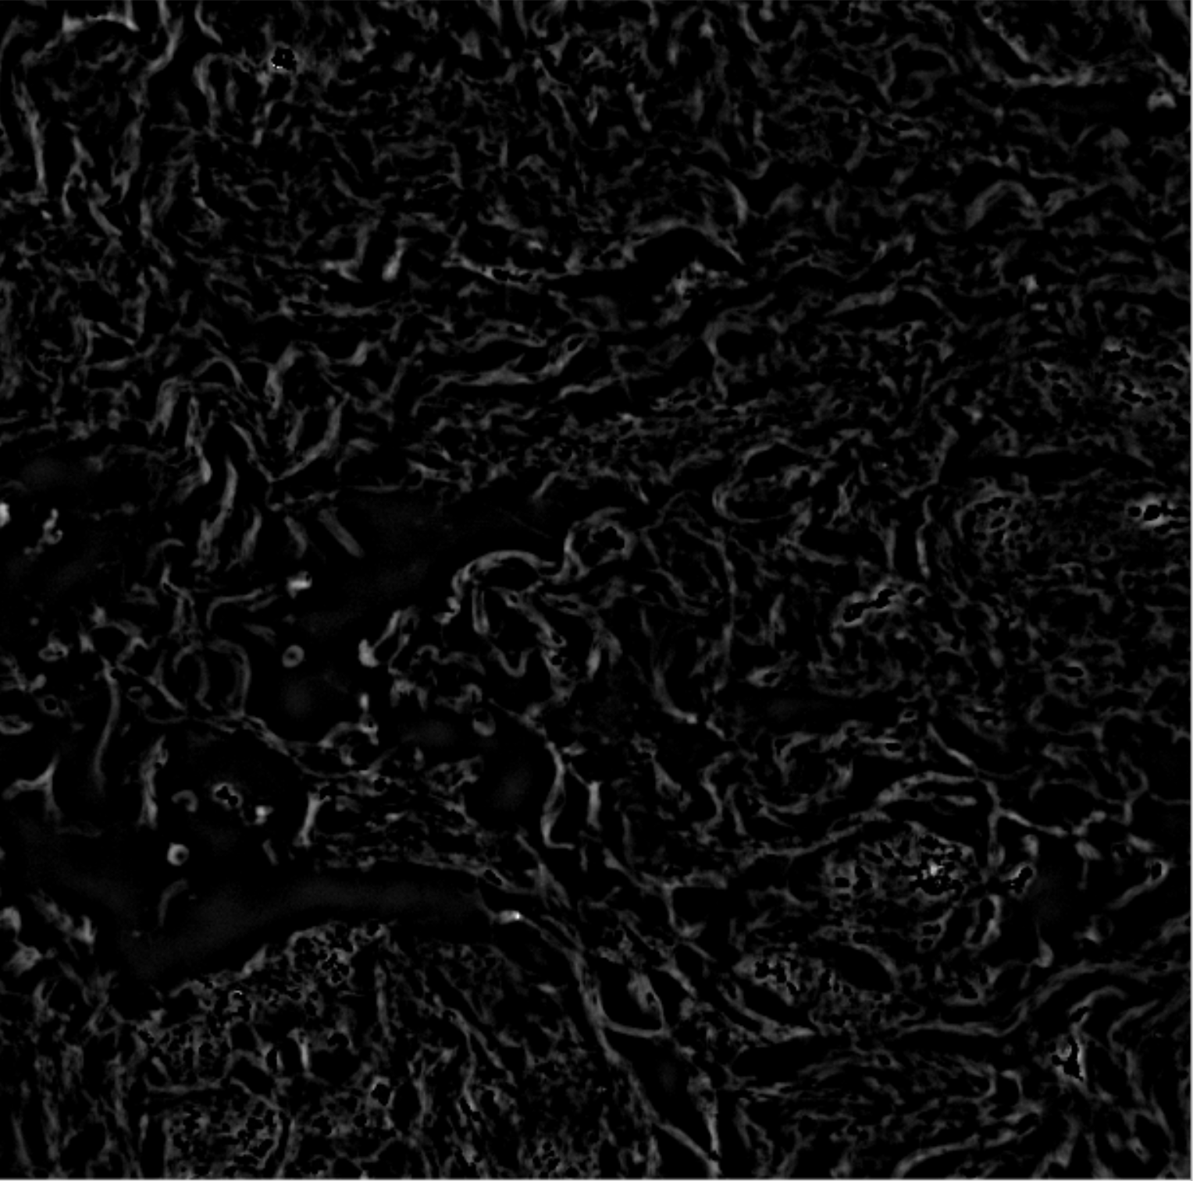
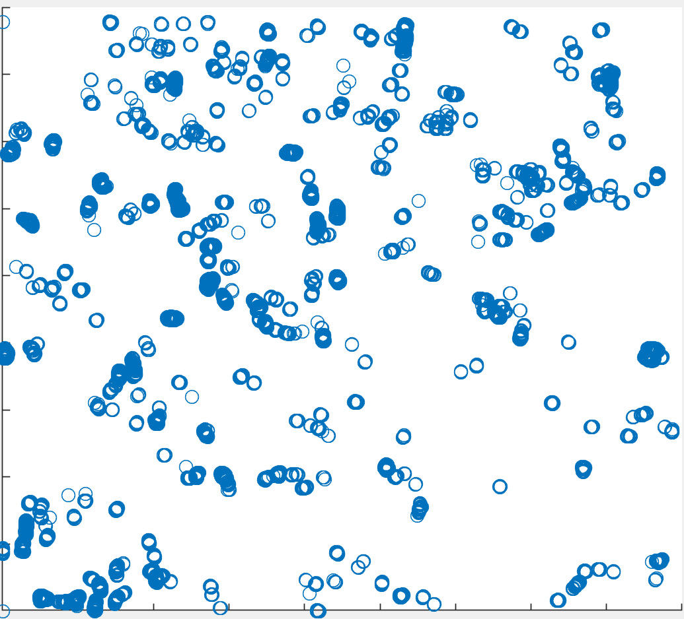
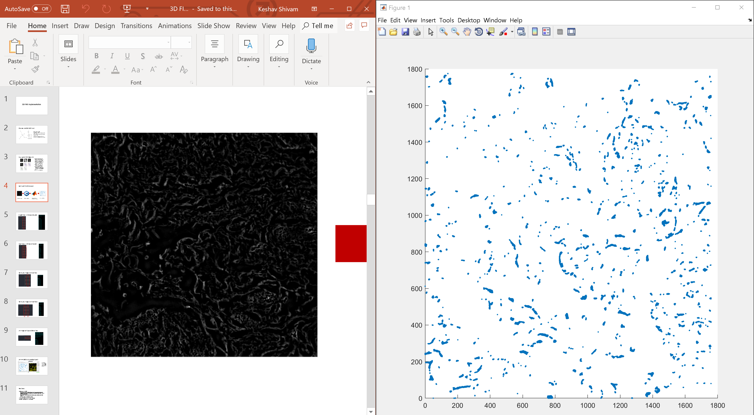
Original, non corrected 3D FIRE algorithm.
Afterwards, added accuracy/speedup improvements including:
More accurate foreground-background pixel determination that does not need brute force
Prevent expanding nucleation points in the DFS other than the current one
Added global explored set to prevent fibers from being rexplored

Slide 2
Ran in ~5 minutes
Inspection of the fibers object reveals that all the dots on the right were classified as a single fiber
local maximum box radius was 250 pixels, which is 1/8 of the image size- meaning essentially the entire image was explored on the first DFS search

Slide 3
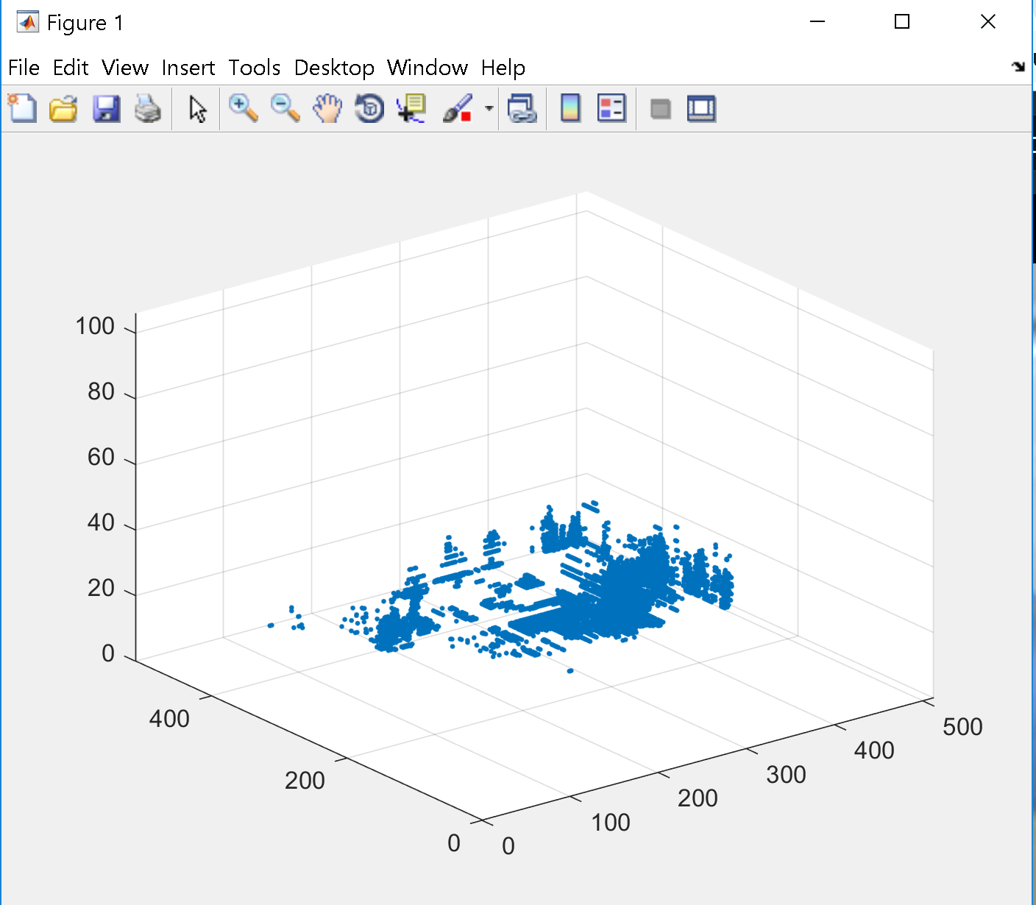
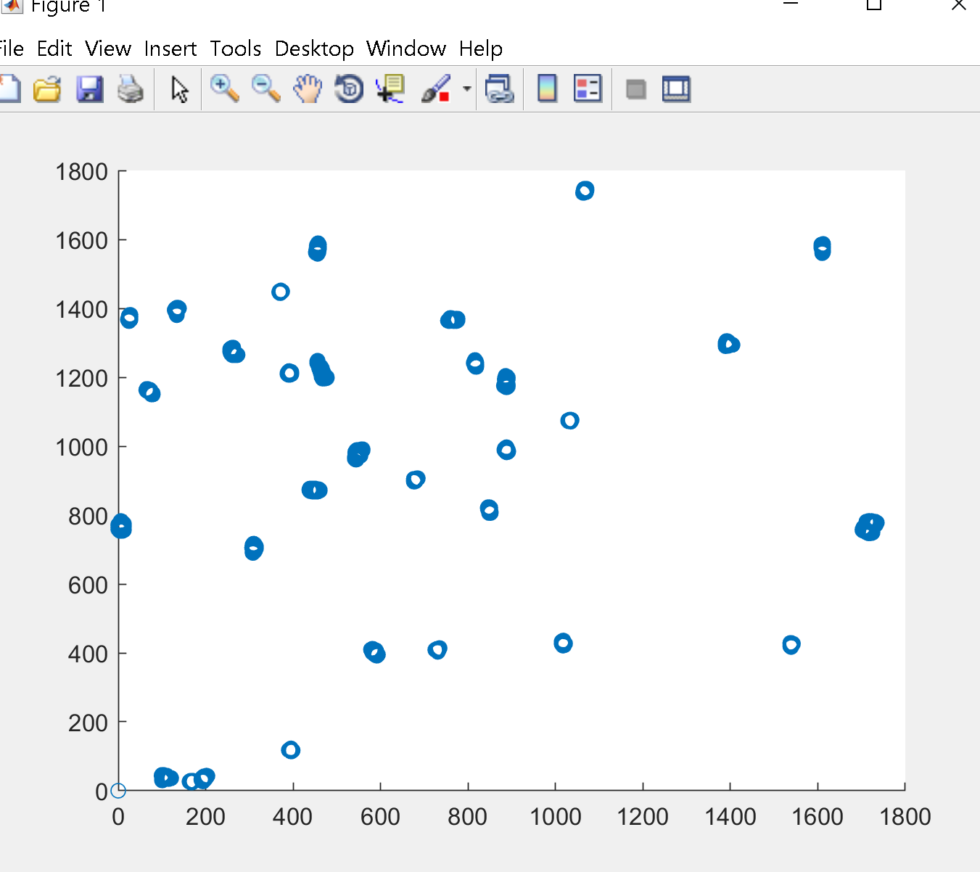
First 3D test on fluorescent data
Took ~1 hour to run
Binary threshold and nucleation point threshold are slightly too high
All dots were still classified as a single fiber again!
fibers = FiberFinder(106, 512, 512, imgArray, 15, 80, 30, 100, 0);
Running an instance with a smaller local maximum point box radius does not finish even ~1 % in two hours
Must optimize the DFS search itself, by limiting the depth of exploration for each nucleation point
Additionally, if a fiber is expanding outward in one direction, the current DFS allows it to traverse the opposite direction
fibers = FiberFinder(106, 512, 512, imgArray, 15, 100, 75, 250, 30);

Slide 4
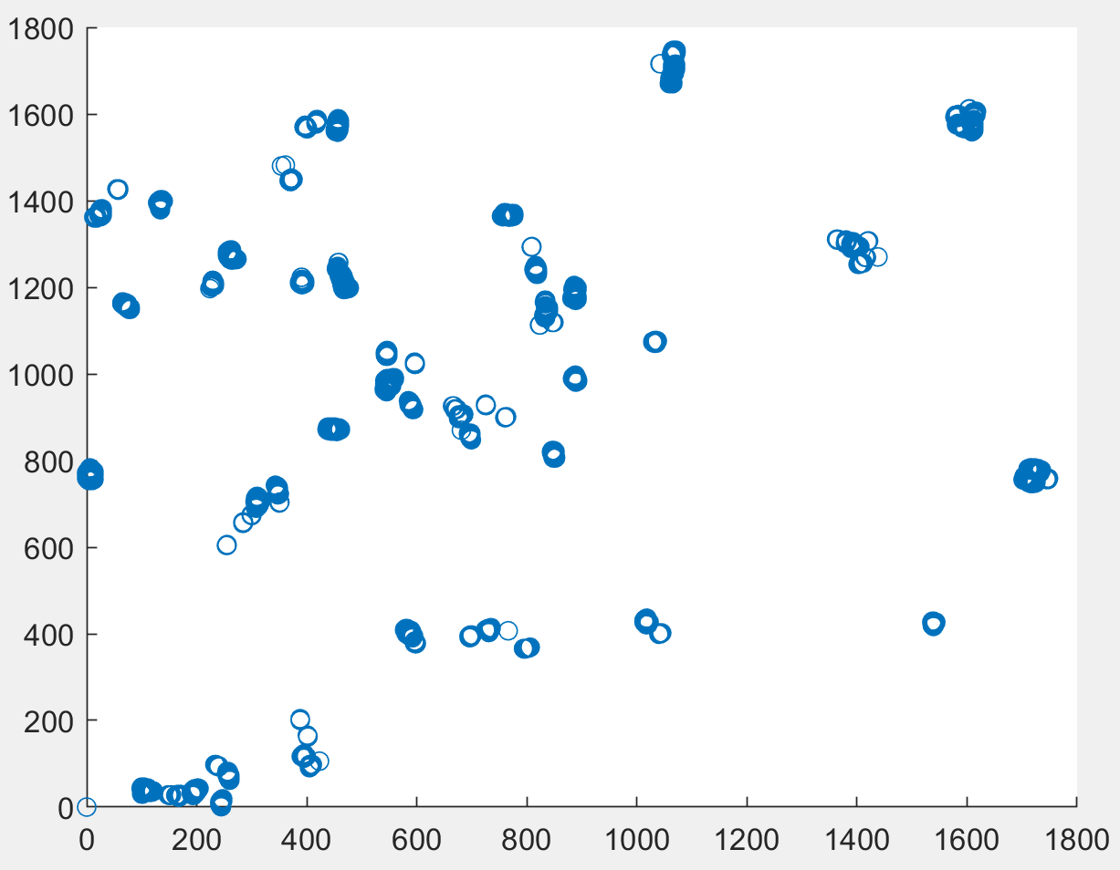
Ran in ~40 minutes
fibers = FiberFinder(1, 1760, 1776, imgArray, 0.35, 5, 2, 50, 5);
Prevented DFS from expanding past a maximum fiber length

Slide 5
fibers = FiberFinder(1, 1760, 1776, imgArray, 0.35, 5, 2, 2, 5);
Took ~1 hour to run.
Nucleation point and local maximum point thresholds are correct, but local maximum point box radius is too small
Decreasing box radius drastically worsened run time (as expected)

Slide 6
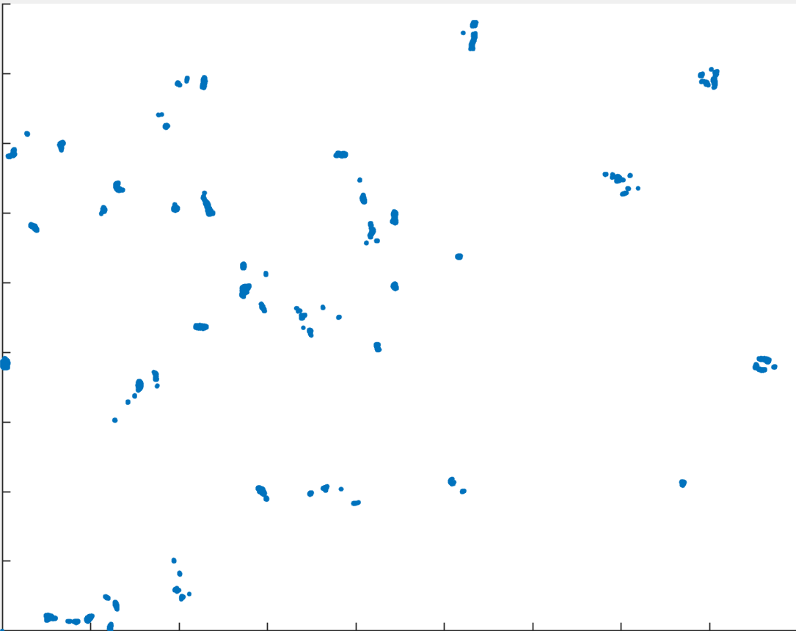
Ran in ~2 minutes
fibers = FiberFinder(1, 1760, 1776, imgArray, 0.35, 5, 2, 50, 0);
Prevented DFS from expanding past a maximum fiber length
Prevented DFS from expanding past a maximum depth
Allowed fibers to expand into other nucleation points
Results are essentially the same, but run time is much faster.

Slide 7
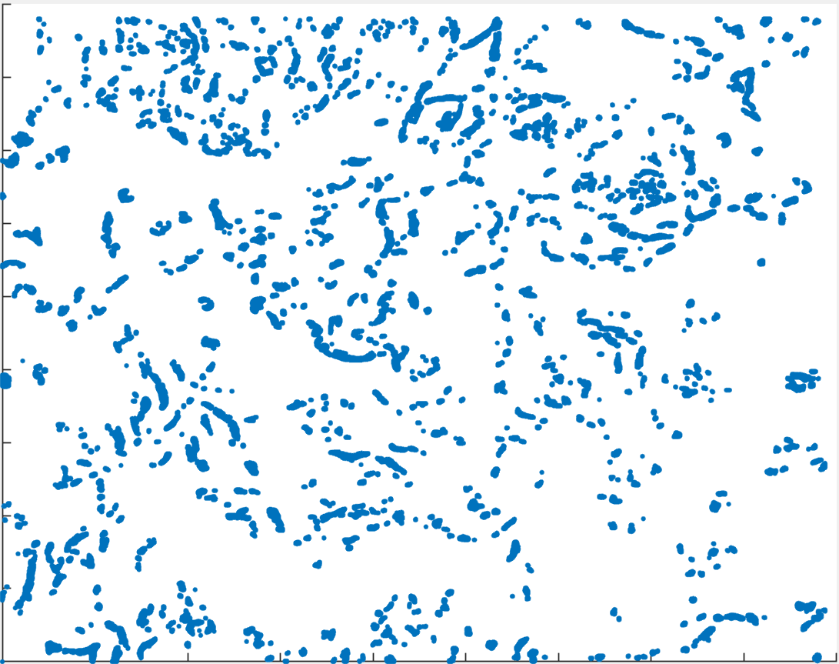
Ran in ~20 minutes
fibers = FiberFinder(1, 1760, 1776, imgArray, 0.20, 5, 2, 30, 0);
Decreasing binary threshold led to more accurate fibers being drawn
194 fibers were identified, not all marked as one fiber!

Slide 8
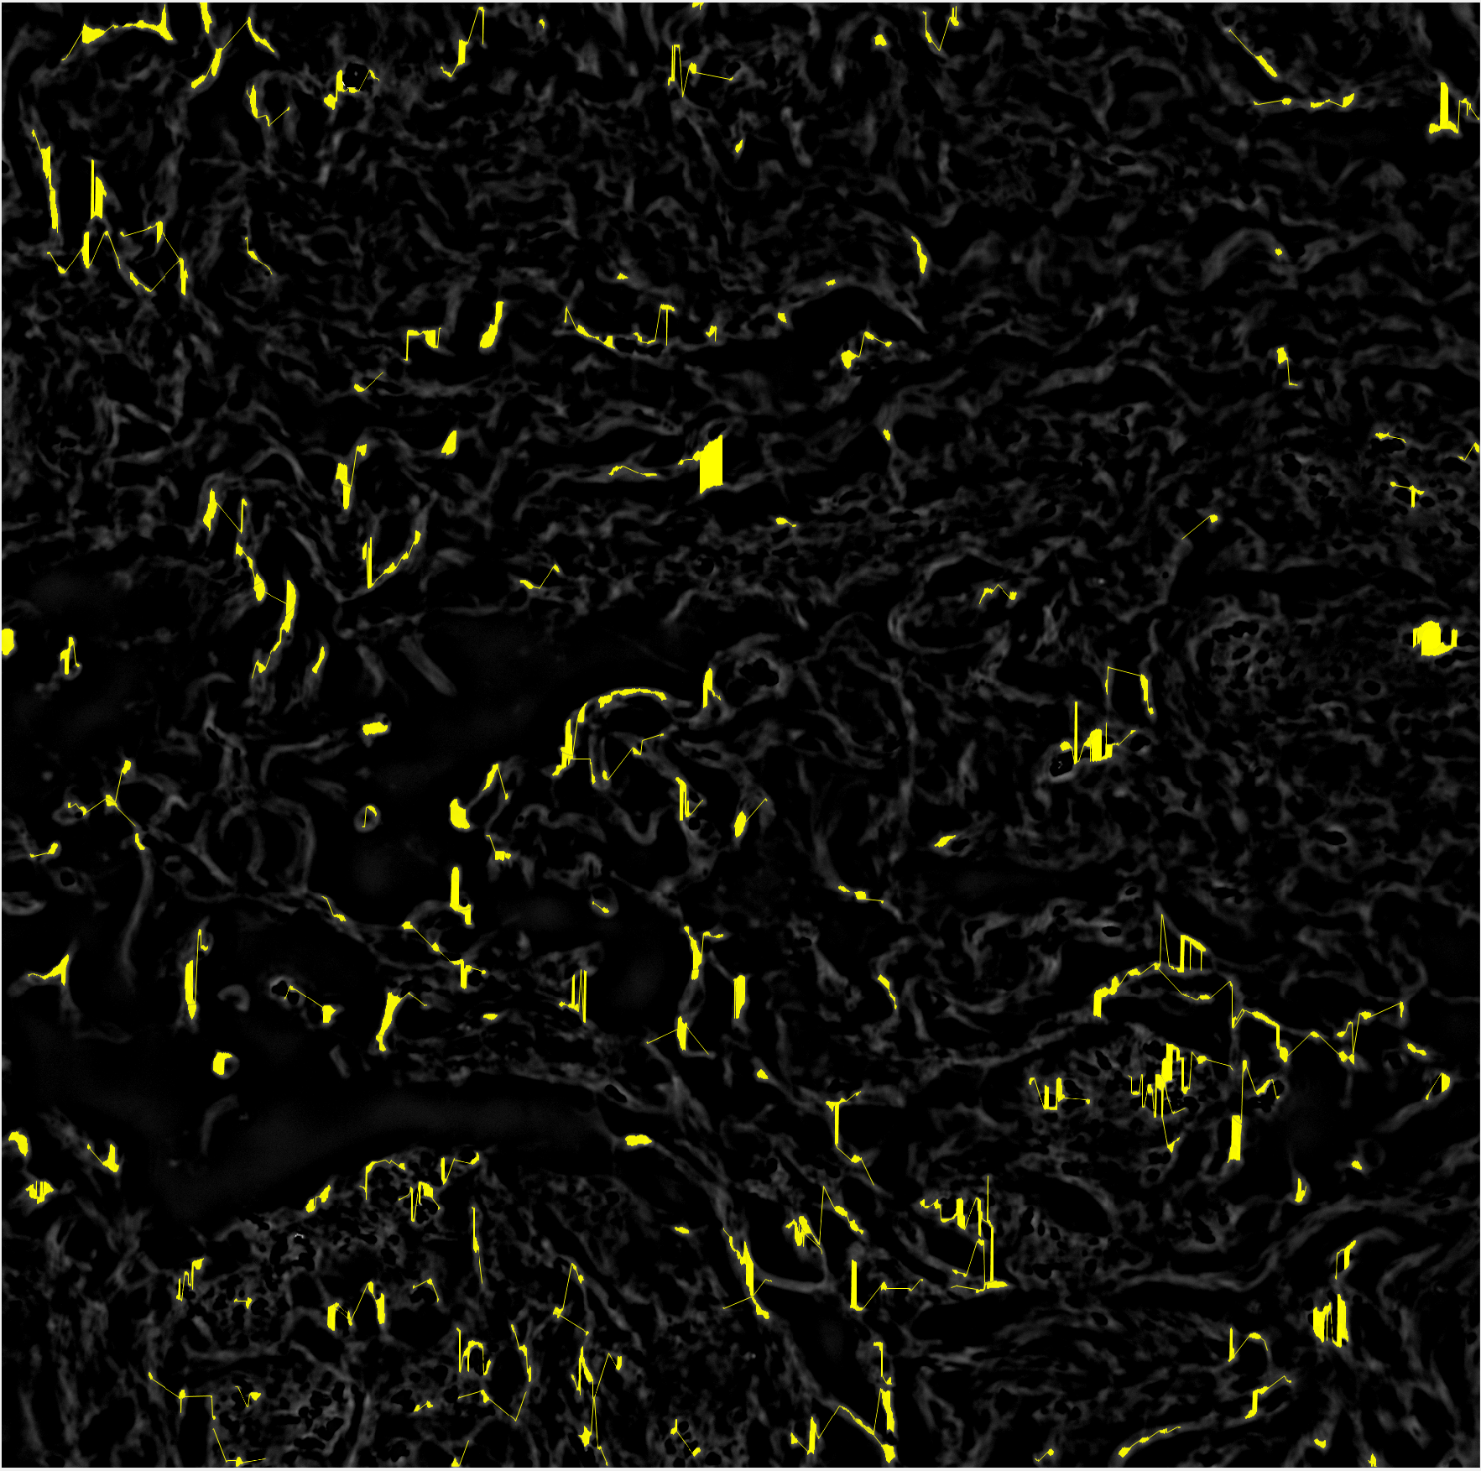
Ran in ~30 minutes
fibers = FiberFinder(1, 1760, 1776, imgArray, 0.25, 5, 2, 40, 0);
Binary threshold was too high, only 171 fibers identified.
If lower threshold for binarizing to be used, then must lower the DFS depth to compensate for runtime

Slide 9
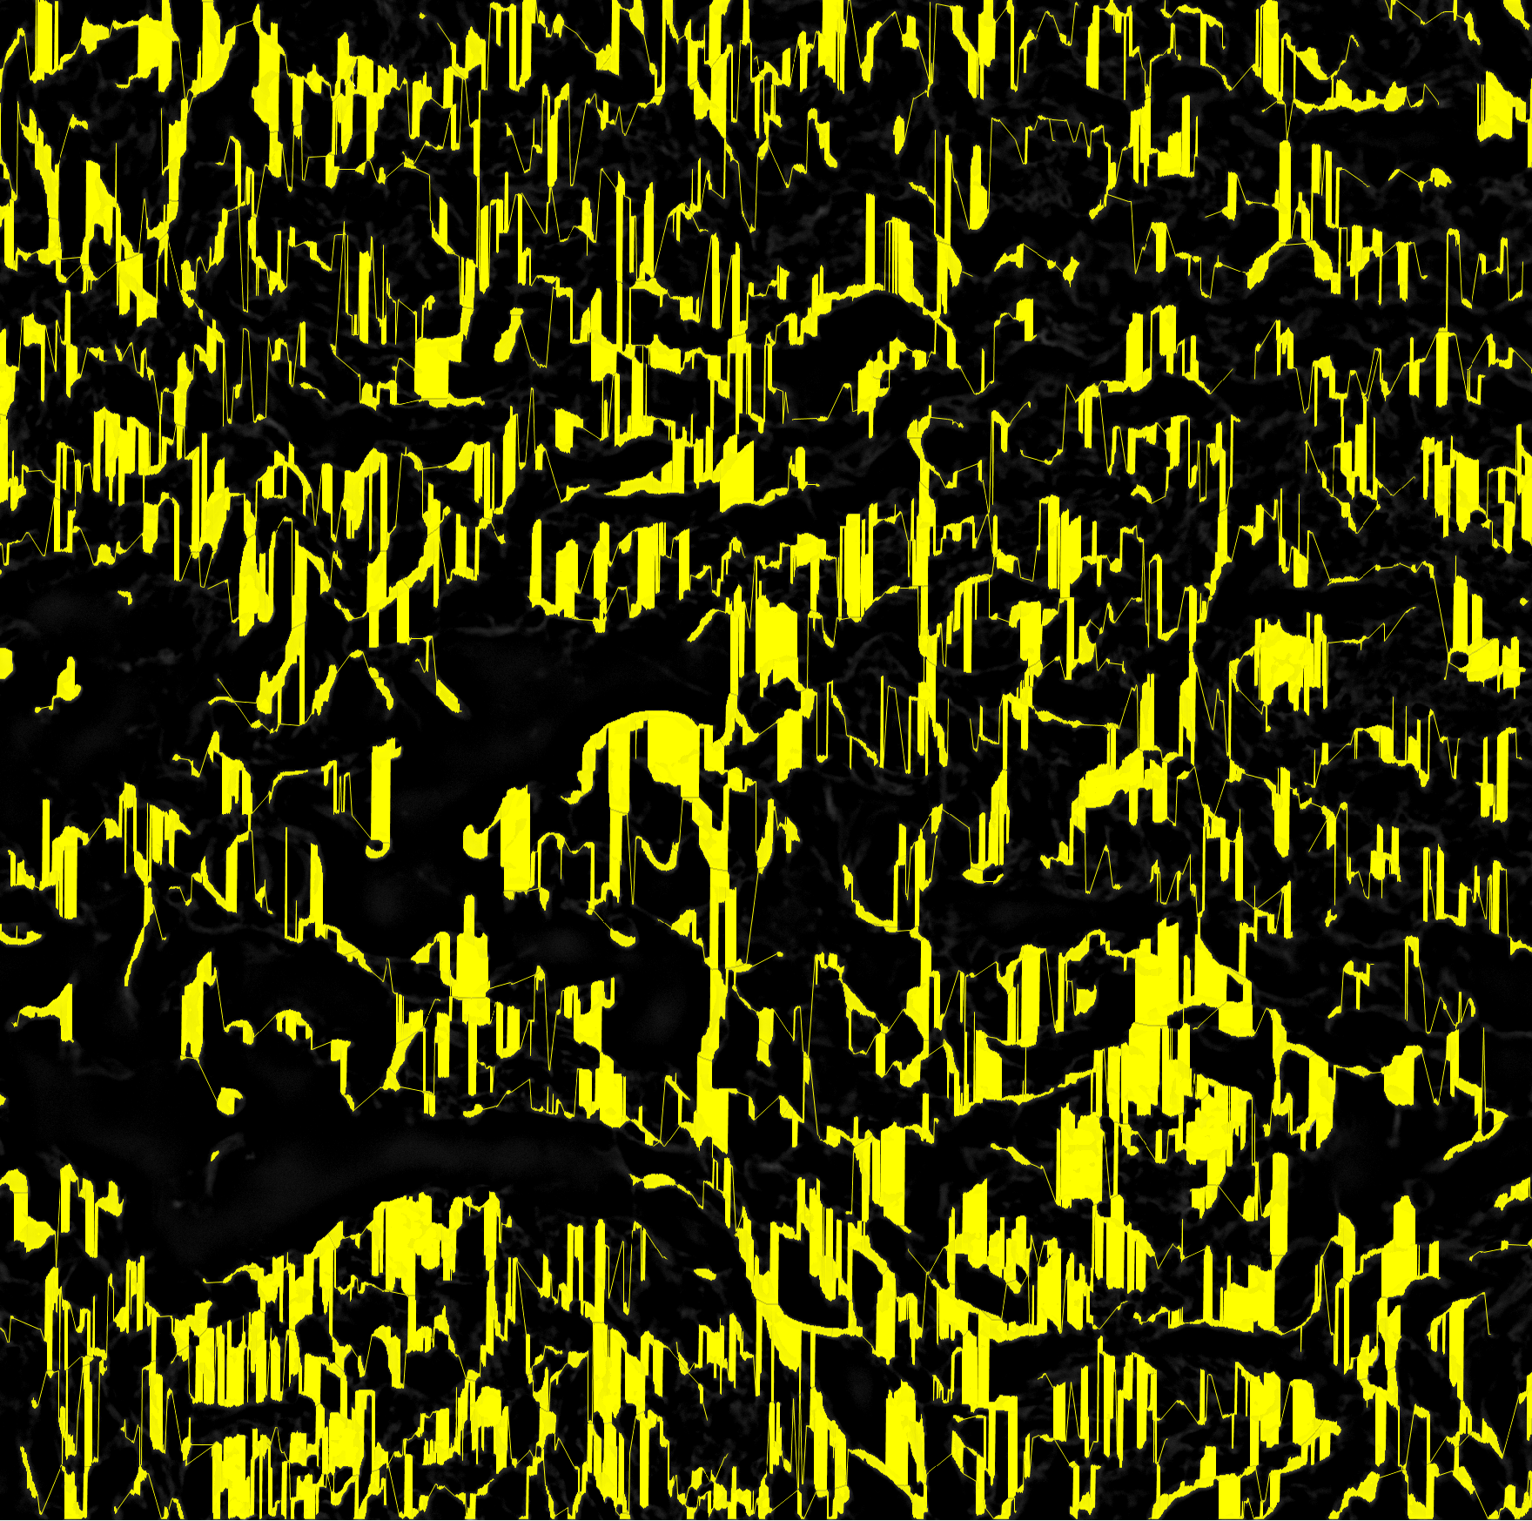
Ran in ~30 minutes
fibers = FiberFinder(1, 1760, 1776, imgArray, 0.20, 5, 2, 30, 0);
If lower threshold for binarizing to be used, then must lower the DFS depth, increase lmp box radius to compensate for runtime.
233 fibers were identified
Vertical lines visible because lmp box radius was too high, connecting parallel fibers.

Slide 10
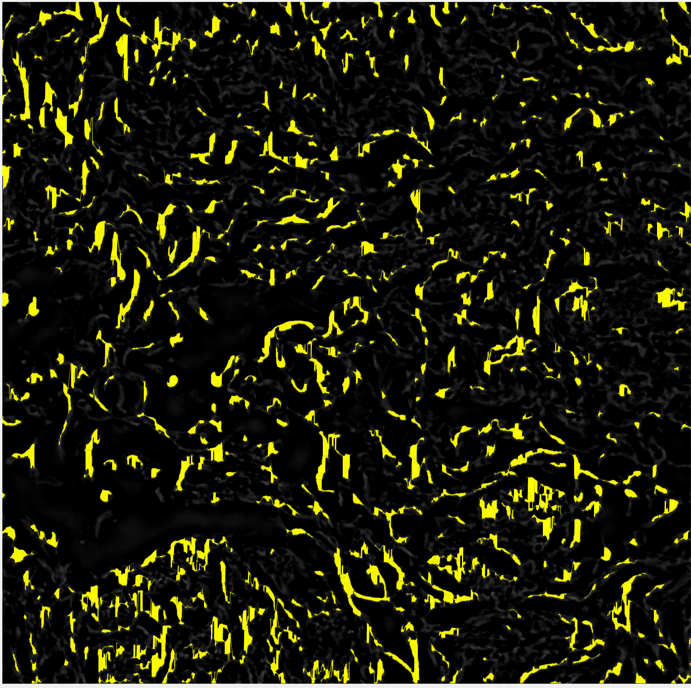
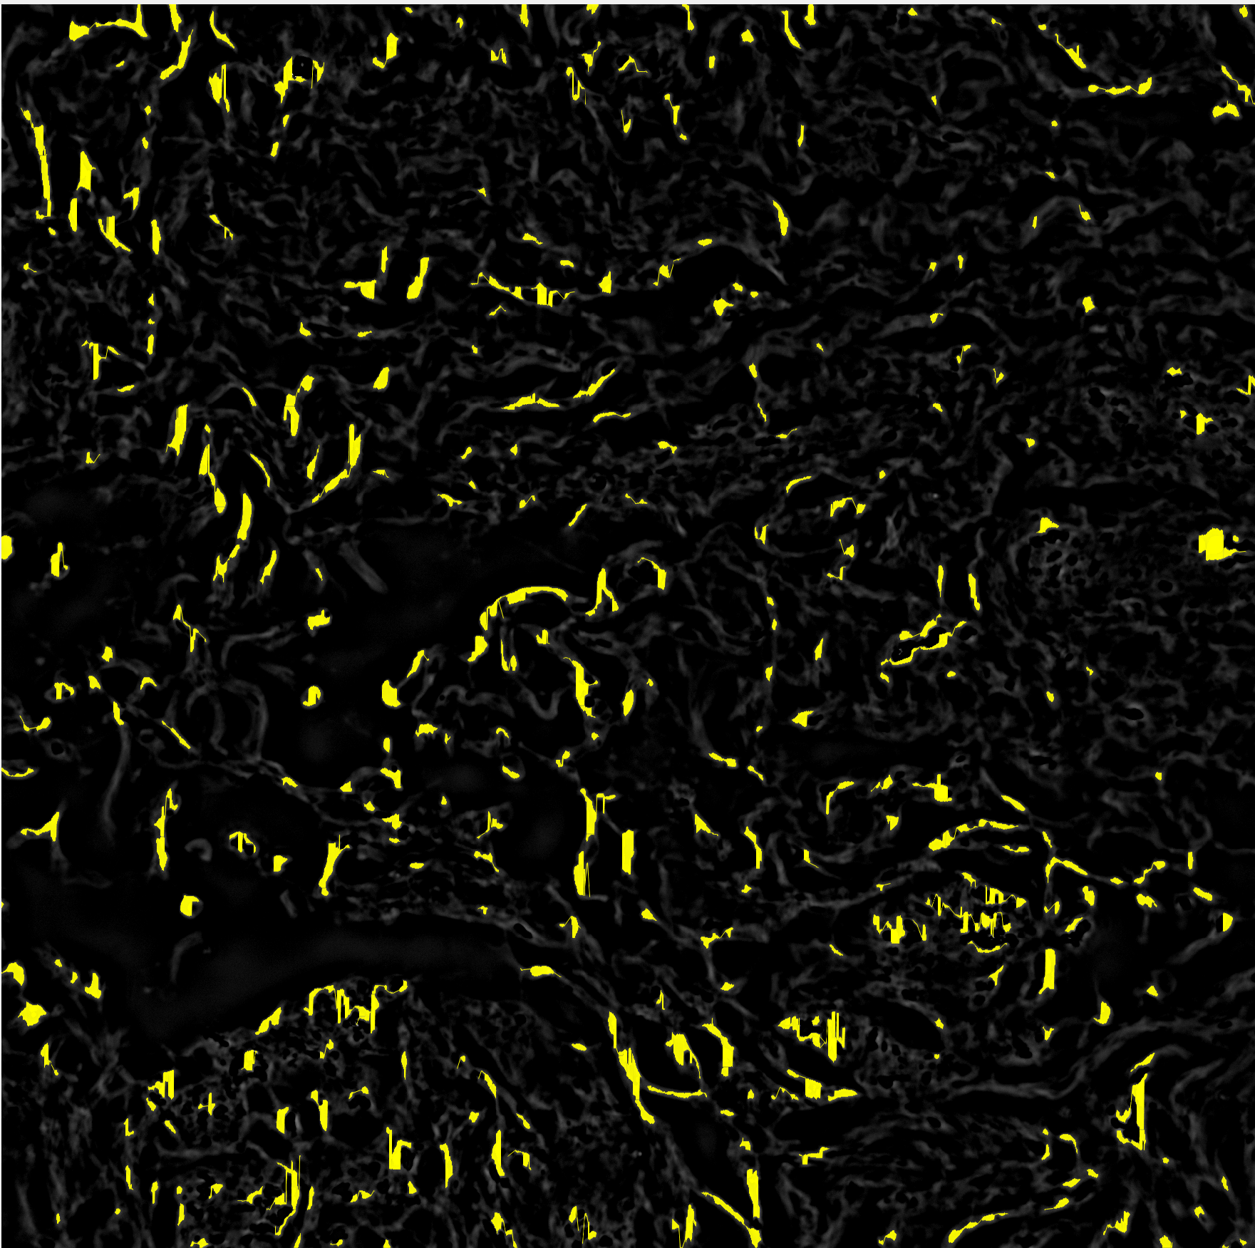
Ran in ~1-2 hrs
fibers = FiberFinder(1, 1760, 1776, imgArray, 0.20, 5, 2, 10, 0);
602 fibers were identified, 52,000 nucleation points were expanded
lmp box radius of 10 is still too high.

